Slide 1
Database for SMILE Foundation

Slide 2
Introduction
Smile Foundation (SSF) is a non-profit organization dedicated to spreading smiles among underprivileged children through education and awareness. Founded in January 2019 by Nitin Jain, SSF initially focused on providing education to slum children, aiming to eliminate social issues like begging and rag picking. Over the past five years, SSF’s mission has expanded, encompassing children, women and marginalized communities from various backgrounds who lack basic facilities.
Committed to social change, SSF comprises members from diverse backgrounds, including students, professionals, and homemakers.

Slide 3
Entities and their attributes—SMILE Foundation
# program_detail table
program_id
program_name
start_date
end_date
location
# donor_detail table
donor_id
donor_name
donor_type
contact_person
address
phone_number
email
Pan_gst_number

Slide 4
Entities and their attributes—SMILE Foundation
# donation_detail table
donation_id
donor_id
program_id
donation_date
amount int,
payment_method
Nationality
currency
# Beneficiaries _detail table
beneficiary_id
first_name
last_name
gender
date_of_birth
address
phone_number
email
beneficiary_type

Slide 5
Entities and their attributes—SMILE Foundation
# Beneficiary_Program_detail table
beneficiary_program_id
beneficiary_id
program_id
enrollment_date
End_date
# staff_detail table
staff_id int
first_name
last_name
gender
date_of_birth
position
email
phone_number
salary
program_id
location
supervisor_id

Slide 6
Entities and their attributes—SMILE Foundation
# events_detail table
event_id
event_name
description
event_date
location
program_id
event_end_date
# Volunteer_detail table
volunteer_id
first_name
last_name
gender
date_of_birth
email
phone_number
program_id
hours_contributed
workplace

Slide 7
Entities and their attributes—SMILE Foundation
# training_detail table
training_id
training_name
start_date
end_date
location
trainer_name
program_id
no_of_participants
No_of_trainers
# healthcare_detail table
healthcare_id
beneficiary_id int,
service_type
service_date
health_issue
doctor_name
prescribed_medicines

Slide 8
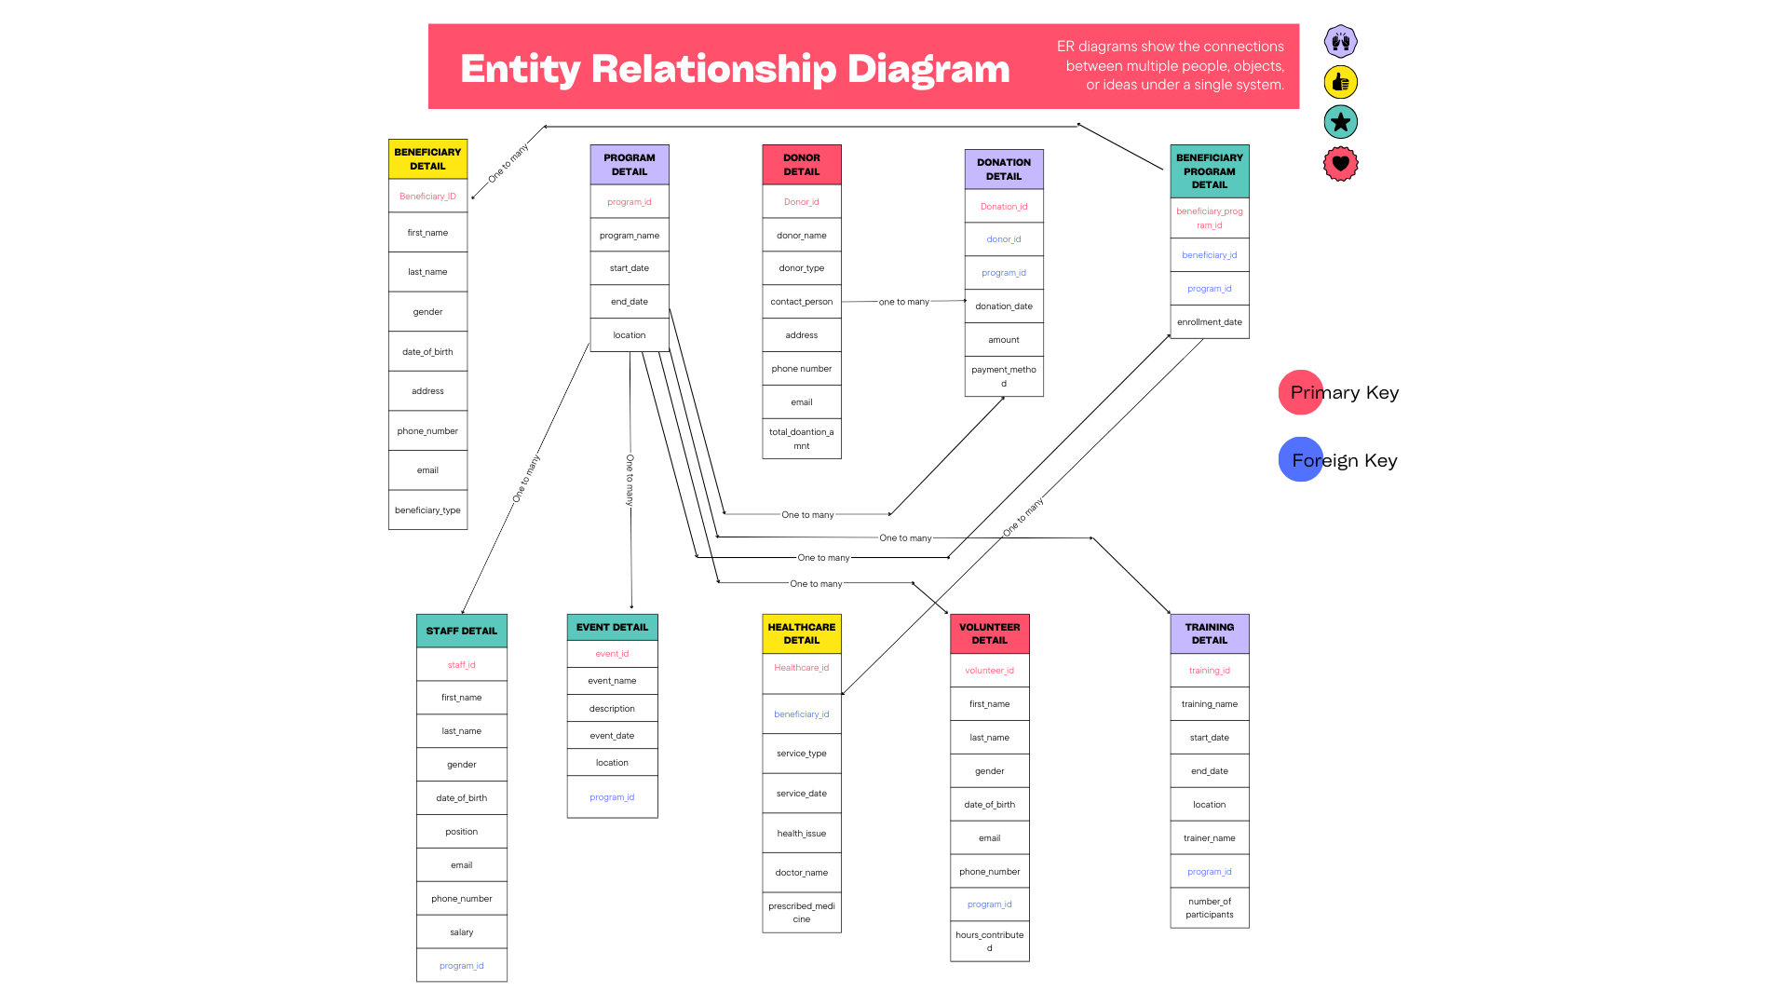

Slide 9
Business Queries
Query to fetch all beneficiaries in the first program.
SELECT B.first_name, B.last_name, B.gender,B.date_of_birth
FROM beneficiary_detail as B ,beneficiary_program_detail as V
WHERE V.program_id = ‘1’ AND B.beneficiary_id = V. beneficiary_id;
Query to fetch all staff members
SELECT first_name, last_name, position
FROM Staff_detail;
Query to fetch all donor details who have donated more than a certain amount during every deposit.
SELECT S.donor_name, D.amount,D.donation_date
FROM donation_detail as D,donor_detail as S
WHERE D.amount>50000 AND S.donor_id = D.donor_id;

Slide 10
Query to list all training programs with more than a certain number of participants
SELECT P.program_id,P.program_name,T.training_name,T.no_of_participants
FROM training_details as T, program_detail as P
WHERE T.no_of_participants >= 35 AND T.program_id = P.program_id;
Query to list all events organized for a specific program.
SELECT P.program_id,P.Program_name ,E.event_name,E.description
FROM events_detail as E,program_detail as P
WHERE program_name = ‘Empower Youth’ AND E.program_id = P.program_id;
Query to fetch all volunteers contributing more than a certain number of hours.
SELECT first_name,last_name,hours_contributed
FROM volunteer_detail
WHERE hours_contributed>25;

Slide 11
Query to fetch names of donors who have done multiple number of donations
SELECT donor_id,donor_name
FROM donor_detail as V
WHERE (
SELECT COUNT(*)
FROM donation_detail as D
WHERE V.donor_ID = D.donor_id)>1;
Query to find beneficiaries who received healthcare services for a specific health issue---Fever
SELECT B.first_name,B.last_name,H.service_date,H.health_issue
FROM beneficiary_detail as B, healthcare_details as H
WHERE health_issue = ‘Fever’ AND B.beneficiary_id = H. beneficiary_id;

Slide 12
Query to list all events organized for a specific program—‘Smile on Wheels’
SELECT P.prodram_name,E.event_name,E.description
FROM events_detail as E, program_detail as P
WHERE program_name = ‘Smile on Wheels’ AND E.program_id = P.program_id;
Query to find all healthcare services provided to beneficiaries in a specific year.
SELECT B.first_name, B.last_name, H.service_type, H.service_date, H.health_issue, H.doctor_name
FROM (Beneficiary_detail as B JOIN Healthcare_details as H ON B.beneficiary_id = H.beneficiary_id )
WHERE H.service_date BETWEEN '2023-01-01' AND '2023-12-31';
Thank You

